Slide 1
ECE 8893 Lab 1
Pulkit Gupta

Slide 2
Optimization types
Software:
Removing redundant computation
Changing traversals/iterations to improve locality/parallelizability
Algorithmic optimizations
HLS/Hardware:
FPGA specific code transforms (creating a register where HLS doesn’t)
Pragma tweaks
Interface tweaks

Slide 3
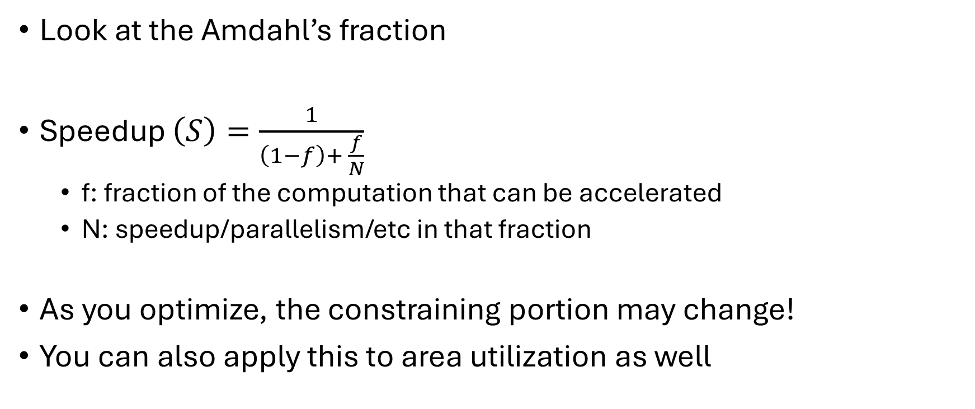
Goals when optimizing
Look at the Amdahl’s fraction
Speedup $\left(S\right)=\frac{1}{\left(1−f\right)+ \frac{f}{N}}$
f: fraction of the computation that can be accelerated
N: speedup/parallelism/etc in that fraction
As you optimize, the constraining portion may change!
You can also apply this to area utilization as well

Slide 4
The computation:
Loop over rows of A
Loop over entries in row
Accumulate
Loop over entries in row
Divide by the row sum and save in tmp
Loop over the columns of tmp
Loop over entries in column of tmp
Accumulate
Loop over entries in column of tmp
Scale by the sum and save in C

Slide 5
SW opt: remove excess iterations
Loop over rows of A
Loop over entries in row
Accumulate
Loop over entries in row
Divide by the row sum and save in tmp
Loop over the columns of tmp
Loop over entries in column of tmp
Accumulate
Loop over entries in column of tmp
Scale by the sum and save in C
If we create an array of column sums, we can populate during the first set of loops

Slide 6
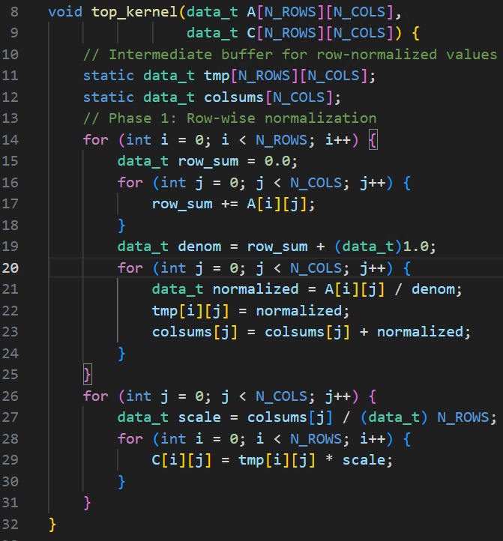
colsums array
Taking the sum of a column while we generate the values.
Removes at least an extra 64*256 cycles

Slide 7
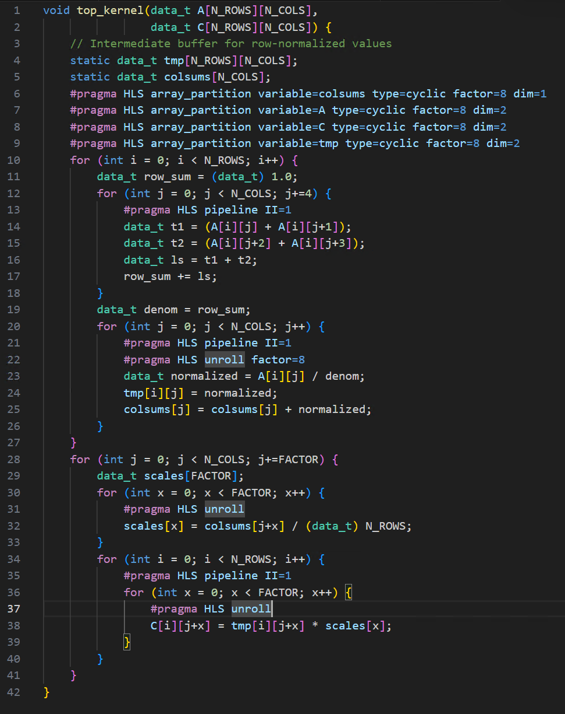
Basic pipelining and unrolling
Unroll inner loops a bit and pipeline where possible
Array partition to allow the unrolled parts to be in parallel
Manually create tree reductions since HLS is dumb
Cannot unroll more because the divider takes too much space

Slide 8
Eliminating the divider
Replace division in the loop with division outside the loop and then multiplications with the reciprocal
Precision becomes a problem.
Array is 64 wide with values between 0.1-9.9. that means the row sum is at most 640
Since its “randomly distributed” lets assume its less than 512.
Reciprocal: 512/denom
Product: (A[i][j] * reciprocal) >> 9

Slide 9
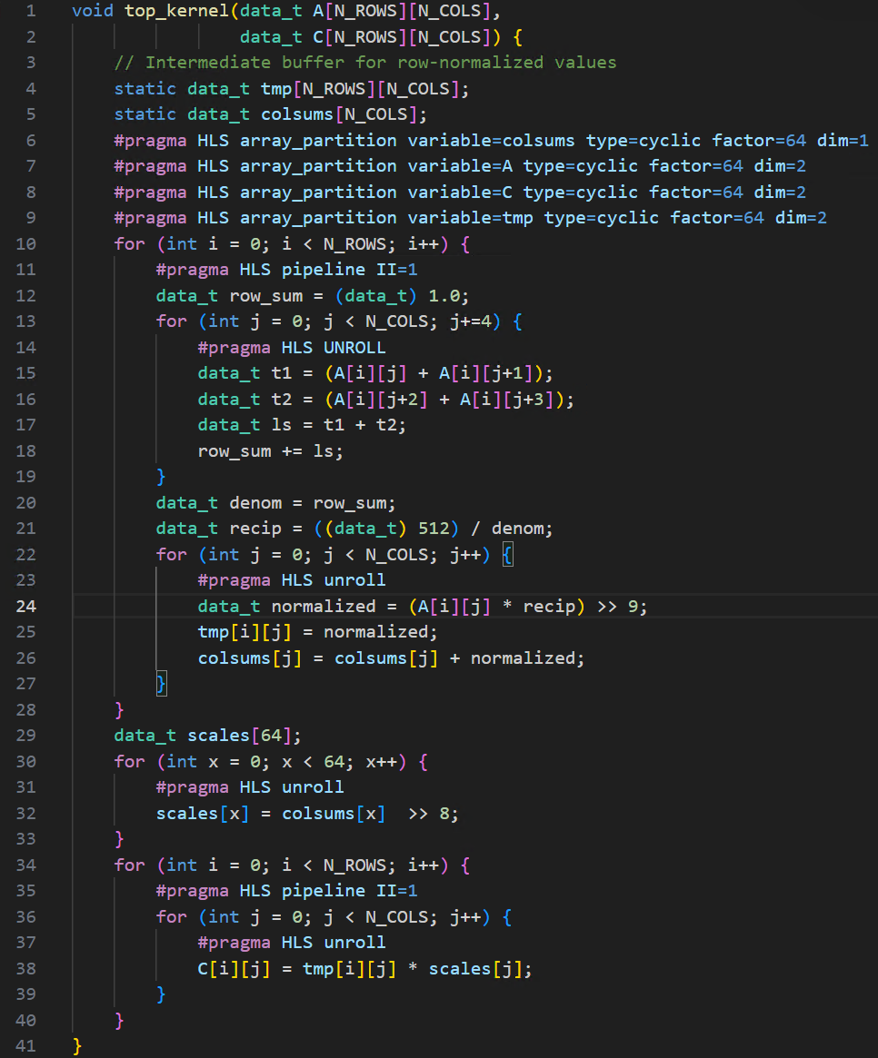
Can even unroll 2 iterations of I inside

Slide 10

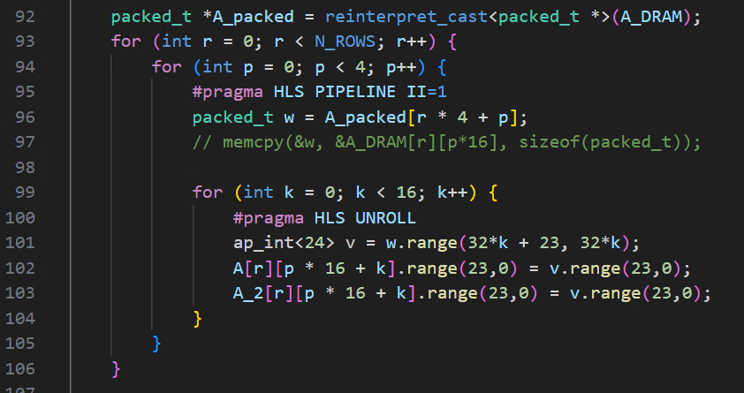
New bottleneck arises Data Movement
Moving the data into and out of dram takes at least 256*64 cycles each time
I was down to ~33000 cycles, 32768 of which is the data movement

Slide 11
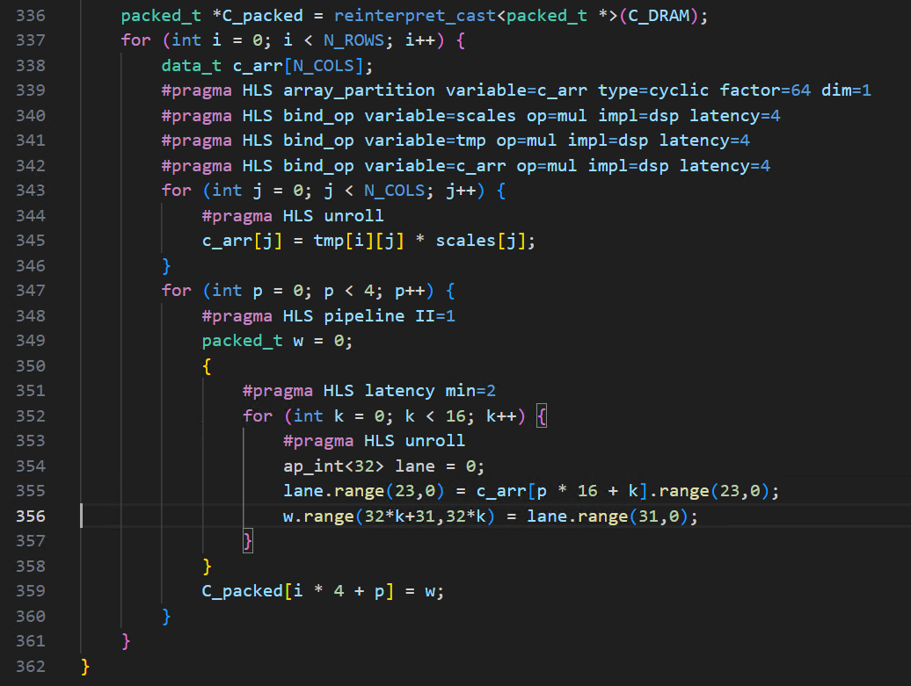
Overlap compute with data movement
Scale elements of c as we write them to dram

Slide 12
Final code
2241 cycles @ 7.177 ns period
2048 cycles of which are the data movement

Slide 13
Even faster code discovered after the deadline
1083 cycles @ 7.210 ns
881.3x speedup
Trick HLS into breaking the dram into 2 channels

